Slide 1
EE-357: CCN Mobile Radio Propagation: Large Scale Path Loss
Hassaan Khaliq Qureshi
School of Electrical Engineering & Computer Science
National University of Sciences & Technology (NUST)
Pakistan

Slide 2
The Components
Successful transmission of data relies on two principle factors
(a) Quality of signal being transmitted
(b) Characteristics of transmission medium
The quality of the signal is dependent on how many components its made up from. The more components that make up the wave the more robust it will be – it won’t be difficult to interpret it will be more robust to error etc.

Slide 3
Layers of a Typical Communication Systems
Contemporary communication systems comprise different protocol layers
A typical protocol stack contains the following layers
Application Layer
Transport Layer
Network Layer
MAC Sublayer
Data Link Layer
Physical Layer
Notes:
Hz = s⁻¹, therefore Hz⁻¹ = s. Hence, bits * s⁻¹ * Hz⁻¹ = bits * s⁻¹ * s Hence, bits/s/Hz = bits.
So, why use units of bits/s/Hz for spectral efficiency, when "bits/s/Hz" is just a confusing way of saying "bits"?
Because to say, for example, that GSM has a spectral efficiency of 0.52 bits would sound more confusing (although dimensionally correct). bits/s/Hz is the standard unit
In conclusion, we can say bits or bits/Hz but standard one is bits/s/Hz

Slide 4
Layers of a Typical Communication Systems
Physical layer is closest to the transmission medium and is responsible for transmitting and receiving bits on/from the physical medium
Transmission takes place in the form of electromagnetic waves
These waves are modulated by the transmitter and demodulated at the receiver
MAC Sublayer
Data Link Layer
Physical Layer

Slide 5
How is Wireless Different? Physical Layer
Information source
Information sink
Transmitter
(Spect. Reg./Size/power constraints)
Receiver (Channel Estimation/Error Correction)
Channel
Wireless is different because of its channel which is:
Noisy: due to attenuation, interference and the signal reaching the receiver from multiple propagation paths, a phenomenon called multipath fading
Time varying: orders of magnitude difference in channel characteristics due to mobility
Shared: bandwidth sharing with and interference from other transmitters
Bandwidth limited: Bandwidth of a radio propagation path is much less than that of a guided wired medium
Notes:
Wireless transmitters and receivers are designed to cope with the challenges of the wireless channel
A wireless transmitter’s physical layer has to cope with:
Spectrum Regulations: A government body generally allocates and regulates use of the wireless spectrum. A wireless transmitter must adhere to the allocated spectrum.
Shared Channel: The channel is often shared between multiple transmitters, so they must reduce interference with each other (Regulated).
Size and Power Constraints: Most wireless transceivers are mobile and battery powered. Therefore, size and power are serious constraints in a wireless system.
Physical layer of a wireless receiver has to perform:
Channel Estimation: To track or estimate the noisy, time-varying channel behavior continuously in order to provide reliable communication
Error Correction: Error detection and correction must be implemented at the receiver
Synchronization: Between the sender and receiver must be maintained at all times

Slide 6
Wireless Communications: Design Factors
Bandwidth
higher bandwidth gives higher data rate
Transmission impairments
eg. Attenuation
Impairments, such as attenuation, limit the distance
Interference: Interference from competing signals in overlapping frequency bands can distort or wipe out a signal. Interference is of particular concern for unguided wireless medium.
Notes:
A number of design factors relating to the transmission medium and the signal determine the data rate and distance:
• Bandwidth: All other factors remaining constant, the greater the bandwidth of a signal, the higher the data rate that can be achieved.
• Transmission impairments: Impairments, such as attenuation, limit the distance. For guided media, twisted pair generally suffers more impairment than coaxial cable, which in turn suffers more than optical fiber.
• Interference: Interference from competing signals in overlapping frequency bands can distort or wipe out a signal. Interference is of particular concern for unguided media, but is also a problem with guided media. For guided media, interference can be caused by emanations from nearby cables. For example, twisted pairs are often bundled together and conduits often carry multiple cables. Interference can also be experienced from unguided transmissions. Proper shielding of a guided medium can minimize this problem.
• Number of receivers: A guided medium can be used to construct a point-to-point link or a shared link with multiple attachments. In the latter case, each attachment introduces some attenuation and distortion on the line, limiting distance and/or data rate.

Slide 7
Wireless Transmission Frequencies
1GHz to 40GHz [limit is different in different books]
microwave
highly directional beams are possible
point to point
satellite
30MHz to 1GHz
Omni-directional applications
broadcast radio
3 x 10¹¹ to 2 x 10¹⁴
Infrared (useful to local point-to-point and multipoint applications within confined areas, such as a single room.)
Notes:
Unguided transmission techniques commonly used for information communications include broadcast radio, terrestrial microwave, and satellite. Infrared transmission is used in some LAN applications. Three general ranges of frequencies are of interest in our discussion of wireless transmission.
Frequencies in the range of about 1 to 40 GHz are referred to as microwave frequencies. At these frequencies, highly directional beams are possible, and microwave is quite suitable for point-to-point transmission. Microwave is also used for satellite communications.
Frequencies in the range of 30 MHz to 1 GHz are suitable for omnidirectional applications. We refer to this range as the radio range.
Another important frequency range is the infrared portion of the spectrum, roughly from 3 × 10¹¹ to 2 × 10¹⁴ Hz. Infrared is useful to local point-to-point and multipoint applications within confined areas, such as a single room.

Slide 8
Broadcast Radio
Radio is 3kHz to 300GHz
Term broadcast radio is used, below 300MHz, for:
FM radio
UHF and VHF television (ranged 170-230 MHZ)
is omnidirectional
However, still needs line of sight above 300Mhz for majority of applications
suffers from multipath interference
reflections from land, water, other objects
Notes:
Radio is a general term used to encompass frequencies in the range of 3 kHz to 300 GHz. We are using the informal term broadcast radio to cover the VHF and part of the UHF band: 30 MHz to 1 GHz. This range covers FM radio and UHF and VHF television. This range is also used for a number of data networking applications. The principal difference between broadcast radio and microwave is that the former is omnidirectional and the latter is directional. Thus broadcast radio does not require dish-shaped antennas, and the antennas need not be rigidly mounted to a precise alignment.
The range 30 MHz to 1 GHz is an effective one for broadcast communications. Unlike the case for lower-frequency electromagnetic waves, the ionosphere is transparent to radio waves above 30 MHz. Thus transmission is limited to the line of sight, and distant transmitters will not interfere with each other due to reflection from the atmosphere. Unlike the higher frequencies of the microwave region, broadcast radio waves are less sensitive to attenuation from rainfall. A prime source of impairment for broadcast radio waves is multipath interference. Reflection from land, water, and natural or human-made objects can create multiple paths between antennas, eg ghosting on TV pictures.

Slide 9
Decibels
Standard Unit describing transmission gain (loss ) and relative power levels.
Gain= N (db) = 10log (P2/P1)
Decibels above or below 1W: cater in Watts
Decibels above or below 1mW: cater in milli Watts
Notes:
A decibel is one tenth of a bel, a seldom-used unit

Slide 10
Example
If a transmitter produces 50 W of power, express the transmit power in units of dBm and dBW.
dB and dbW are the same thing: the normalization factor is 1 Watt
In dBm, the normalization factor is 1 milli Watts
Solution
P_{T}(dB) = 10 log(50W/1W) = 10xlog(50) – 10 log(1) = 16.989 dBW
P_{T}(dBm) = 10 log(50x10³mW/1mW)=10xlog(50) +30 log(10)=46.989 dBm

Slide 11
Wireless Propagation Modes
A signal radiated from an antenna travels along one of three routes:
Ground wave
Sky wave
Line of sight (LOS)

Slide 12
Wireless Propagation: Ground Wave
Ground wave propagation more or less follows the contour of the earth and can propagate considerable distances, well over the visual horizon.
Several factors account for the tendency of electromagnetic wave in this frequency band to follow the earth's curvature.
One factor is that the electromagnetic wave induces a current in the earth's surface, the result of which is to slow the wavefront near the earth, causing the wavefront to tilt downward and hence follow the earth's curvature.

Slide 13
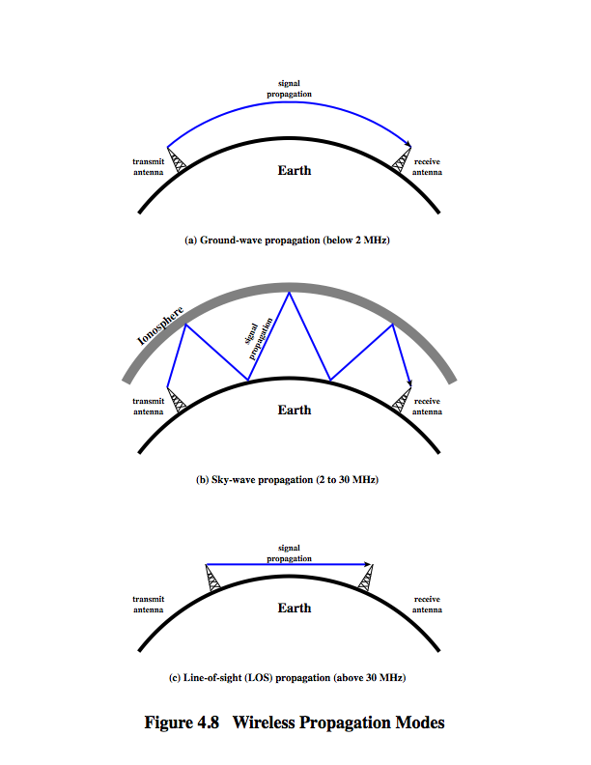
Wireless Propagation: Ground Wave
Notes:
Another factor is diffraction, which is a phenomenon having to do with the behavior of electromagnetic waves in the presence of obstacles.
Electromagnetic waves in this frequency range are scattered by the atmosphere in such a way that they do not penetrate the upper atmosphere. The best-known example of ground wave communication is AM radio.

Slide 14
Wireless Propagation: Sky Wave
Sky wave propagation is used for amateur radio, and international broadcasts such as BBC and Voice of America.
With sky wave propagation, a signal from an earth-based antenna is reflected from the ionized layer of the upper atmosphere (ionosphere) back down to earth.
Although it appears the wave is reflected from the ionosphere as if the ionosphere were a hard reflecting surface, the effect is in fact caused by refraction.
Notes:
Velocity of electromagnetic wave is a function of density of material through which it travels
~3 x 10⁸ m/s in vacuum, less in anything else
speed changes as move between media
Index of refraction (refractive index) is
sin(incidence)/sin(refraction)
varies with wavelength
have gradual bending if medium density varies
density of atmosphere decreases with height
results in bending towards earth of radio waves
hence optical and radio horizons differ
A sky wave signal can travel through a number of hops, bouncing back and forth between the ionosphere and the earth's surface.
With this propagation mode, a signal can be picked up thousands of kilometers from the transmitter.

Slide 15
Wireless Propagation: Sky Wave
Notes:
The ionosphere is a shell of electrons and electrically charged atoms and molecules that surrounds the Earth, stretching from a height of about 50 km to more than 1000 km. The D layer is the innermost layer, 60 km to 90 km above the surface of the Earth. The E layer is the middle layer, 90 km to 120 km above the surface of the Earth. The F layer or region, also known as the Appleton layer extends from about 200 km to more than 500 km above the surface of Earth. It is the densest point of the ionosphere, which implies signals penetrating this layer will escape into space. Ionization depends primarily on the Sun and its activity. The amount of ionization in the ionosphere varies greatly with the amount of radiation received from the Sun. At night the F layer is the only layer of significant ionization present, while the ionization in the E and D layers is extremely low.

Slide 16
Wireless Propagation: Line of Sight
Above 30 MHz, neither ground wave nor sky wave propagation modes operate, and communication must be by line of sight.
For satellite communication, a signal above 30 MHz is not reflected by the ionosphere and therefore a signal can be transmitted between an earth station and a satellite overhead that is not beyond the horizon.
In addition, it can also be used for LOS communication between two transceivers on the ground.

Slide 17
Wireless Propagation: Line of Sight
For ground-based communication, the transmitting and receiving antennas must be within an effective line of sight of each other.
The term effective is used because microwaves are bent or refracted by the atmosphere.
The amount and even the direction of the bend depends on conditions, but generally microwaves are bent with the curvature of the earth and will therefore propagate farther than the optical line of sight.

Slide 18
Effective LOS
Line of sight (LoS) is a type of propagation that can transmit and receive data only where transmit and receive stations are in view of each other without any sort of an obstacle.
However, for Wireless Networks a modified line-of-sight transmission is used, which is made possible through a combination of effects like diffraction, multipath reflection, and rapid handoff. Therefore, receiver should be in an effective region covered by the Transmitter.

Slide 19
Wireless Propagation: Line of Sight

Slide 20
Wireless Propagation: Line of Sight
Free space loss
loss of signal with distance
Atmospheric Absorption
from water vapour and oxygen absorption
Multipath
multiple interfering signals from reflections
Refraction
Bending of signal away from receiver

Slide 21
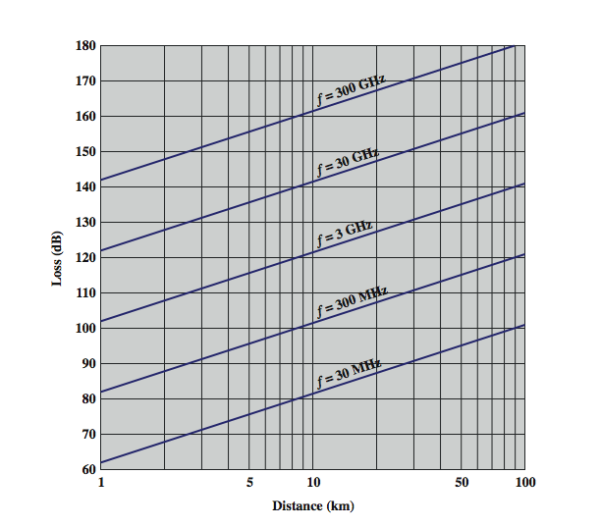
Wireless Propagation: Free Space Loss
Notes:
Free space loss can be expressed in terms of the ratio of the radiated power P_{t} to the power P_{r} received by the antenna or, in decibels, by taking 10 times the log of that ratio, as shown in equation 4.3. Stallings DCC8e Figure 4.10 illustrates the free space loss equation for various frequencies.
See from equation 4.3 that as the frequency increases, the free space loss also increases, which would suggest that at higher frequencies, losses become more burdensome. However, equation 4.) shows that we can easily compensate for this increased loss with antenna gains.

Slide 22
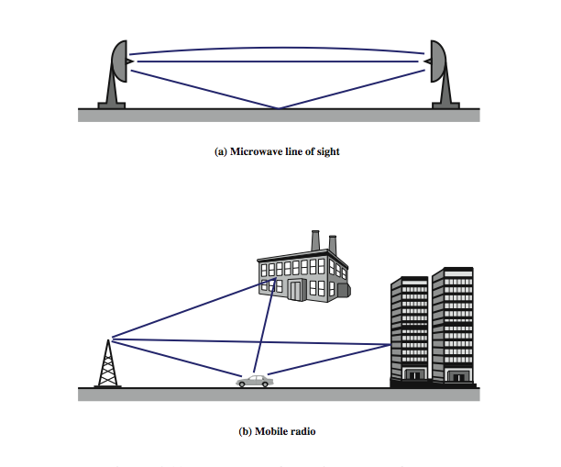
Wireless Propagation: Multipath Interference
Notes:
the types of multipath interference typical in terrestrial, fixed microwave and in mobile communications. For fixed microwave, in addition to the direct line of sight, the signal may follow a curved path through the atmosphere due to refraction and the signal may also reflect from the ground. For mobile communications, structures and topographic features provide reflection surfaces.

Slide 23
Terrestrial Microwave
Used for long haul telecommunications and short point-to-point links
requires fewer repeaters but line of sight
use a parabolic dish to focus a narrow beam onto a receiver antenna [1-40 GHz frequencies]
main source of loss is attenuation
distance, rainfall also interference
Notes:
The primary use for terrestrial microwave systems is in long haul telecommunications service, as an alternative to coaxial cable or optical fiber. The microwave facility requires far fewer amplifiers or repeaters than coaxial cable over the same distance, (typically every 10-100 km) but requires line-of-sight transmission. Microwave is commonly used for both voice and television transmission. Another increasingly common use of microwave is for short point-to-point links between buildings, for closed-circuit TV or as a data link between local area networks.
The most common type of microwave antenna is the parabolic "dish”, fixed rigidly to focus a narrow beam on a receiving antenna A typical size is about 3 m in diameter. Microwave antennas are usually located at substantial heights above ground level to extend the range between antennas and to be able to transmit over intervening obstacles. To achieve long-distance transmission, a series of microwave relay towers is used, and point-to-point microwave links are strung together over the desired distance.
Microwave transmission covers a substantial portion of the electromagnetic spectrum, typically in the range 1 to 40 GHz, with 4-6GHz and now 11GHz bands the most common. The higher the frequency used, the higher the potential bandwidth and therefore the higher the potential data rate. As with any transmission system, a main source of loss is attenuation, related to the square of distance. The effects of rainfall become especially noticeable above 10 GHz. Another source of impairment is interference.

Slide 24
Satellite Microwave
satellite is relay station
receives on one frequency, amplifies or repeats signal and transmits on another frequency
eg. uplink 5.925-6.425 GHz & downlink 3.7-4.2 GHz
typically requires geo-stationary orbit
height of 35,784 km
spaced at least 3-4° apart
typical uses
television
long distance telephone
private business networks
global positioning
Notes:
A communication satellite is, in effect, a microwave relay station. It is used to link two or more ground-based microwave transmitter/receivers, known as earth stations, or ground stations. The satellite receives transmissions on one frequency band (uplink), amplifies or repeats the signal, and transmits it on another frequency (downlink). A single orbiting satellite will operate on a number of frequency bands, called transponder channels, or simply transponders. The optimum frequency range for satellite transmission is in the range 1 to 10 GHz. Most satellites providing point-to-point service today use a frequency bandwidth in the range 5.925 to 6.425 GHz for transmission from earth to satellite (uplink) and a bandwidth in the range 3.7 to 4.2 GHz for transmission from satellite to earth (downlink). This combination is referred to as the 4/6-GHz band, but has become saturated. So the 12/14-GHz band has been developed (uplink: 14 - 14.5 GHz; downlink: 11.7 - 12.2 GHz).
For a communication satellite to function effectively, it is generally required that it remain stationary with respect to its position over the earth to be within the line of sight of its earth stations at all times. To remain stationary, the satellite must have a period of rotation equal to the earth's period of rotation, which occurs at a height of 35,863 km at the equator. Two satellites using the same frequency band, if close enough together, will interfere with each other. To avoid this, current standards require a 4° spacing in the 4/6-GHz band and a 3° spacing at 12/14 GHz. Thus the number of possible satellites is quite limited.
Among the most important applications for satellites are: Television distribution, Long-distance telephone transmission, Private business networks, and Global positioning.

Slide 25
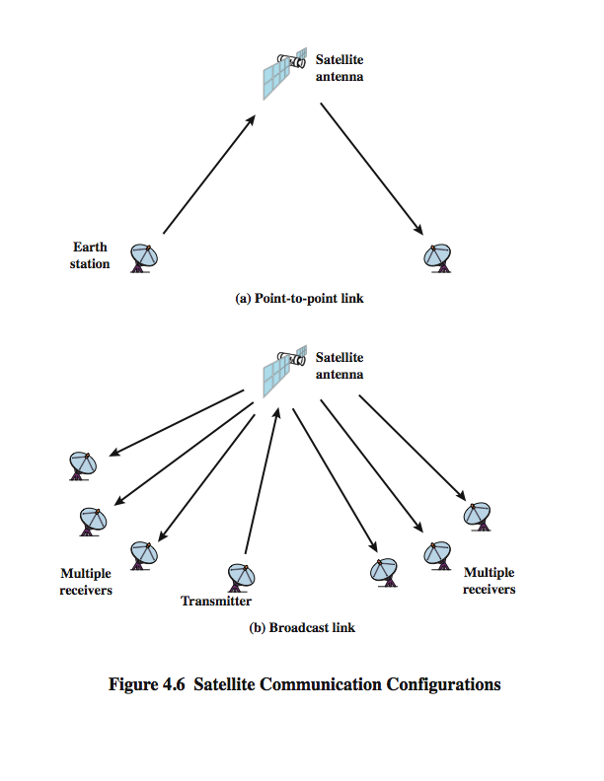
Satellite Point to Point Link
Notes:
depicts in a general way two common configurations for satellite communication. In the first, the satellite is being used to provide a point-to-point link between two distant ground-based antennas.

Slide 26
Satellite Broadcast Link
Notes:
Depicts in a general way two common configurations for satellite communication. In the second, the satellite provides communications between one ground-based transmitter and a number of ground-based receivers.

Slide 27
Noise
The received signal consists of transmitted signal modified by the various distortions imposed by the transmission system.
The major part in various distortions include the unwanted signal that is inserted somewhere between transmission and reception.
This unwanted signal is referred to as noise.
- Noise in a signal with bandwidth B is given by N=N_{o}B
Notes:
Noise in a signal with bandwidth B is given by N=N_{o}B

Slide 28
Noise
Noise may be divided into four categories:
Thermal Noise (N_{o}): Due to thermal agitation of electrons. It is present in all electronic devices and transmission media and is a function of temperature.
N_{o} = K . T (W/Hz)
Where K is Boltzmann constant (1.38 * 10⁻²³)J/k, and T is the temperature in Kelvins.
Notes:
There are other types of noise as well for example
Inter-modulation Noise: When signals at different frequencies share the same transmission medium, the result may be inter-modulation noise. Mixing of signal at f1 and f2 produces an energy at the frequency f1+f2, which interferes with a intended signal at a frequency f1+f2.
Impulse Noise: Consists of irregular pulses and noise spikes of short duration and of relatively high amplitude. Generated from variety of causes including external EM disturbances such as lightening, faults and flaws in the communication system.
Crosstalk: Unwanted coupling of signal paths that occur by electrical coupling of two cables. Can also occur when unwanted signals are picked up by microwave antennas.

